Slide 1
ECNS 460 Project
Alejandro Casillas & Rhys Phelps

Slide 2
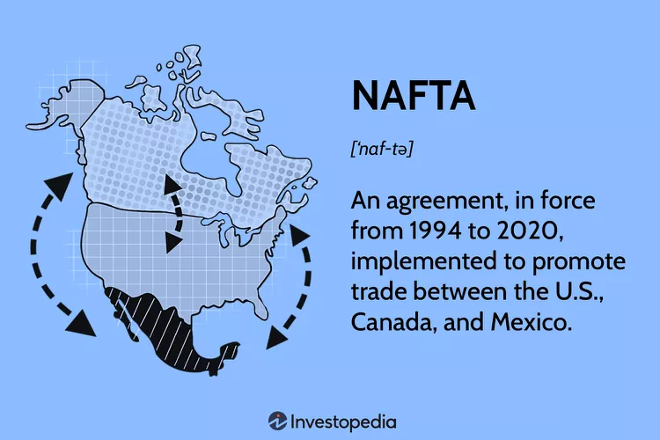
What is NAFTA?
Reduce tariffs on imports and exports between the three participating counties
NAFTA majorly focused to improve trade volumes in Agricultures, Capital Goods, Machine & Technology, Intermediate goods, and Transportation.
NAFTA: 1994 - 2020
USMCA: 2020 - Present

Slide 3
Research Question:
In the context of NAFTA's trade volume objectives, which specific Product Groups experienced the most significant impact in terms of trade dynamics and economic performance?

Slide 4
Manipulations to the Data:
Transposed the Data
“Year” as key variable
Simplified number of Product Groups
22 down to 15
Logged the data
Created new data frames:
NAFTA’s main focus sectors
Rest of the sectors

Slide 5
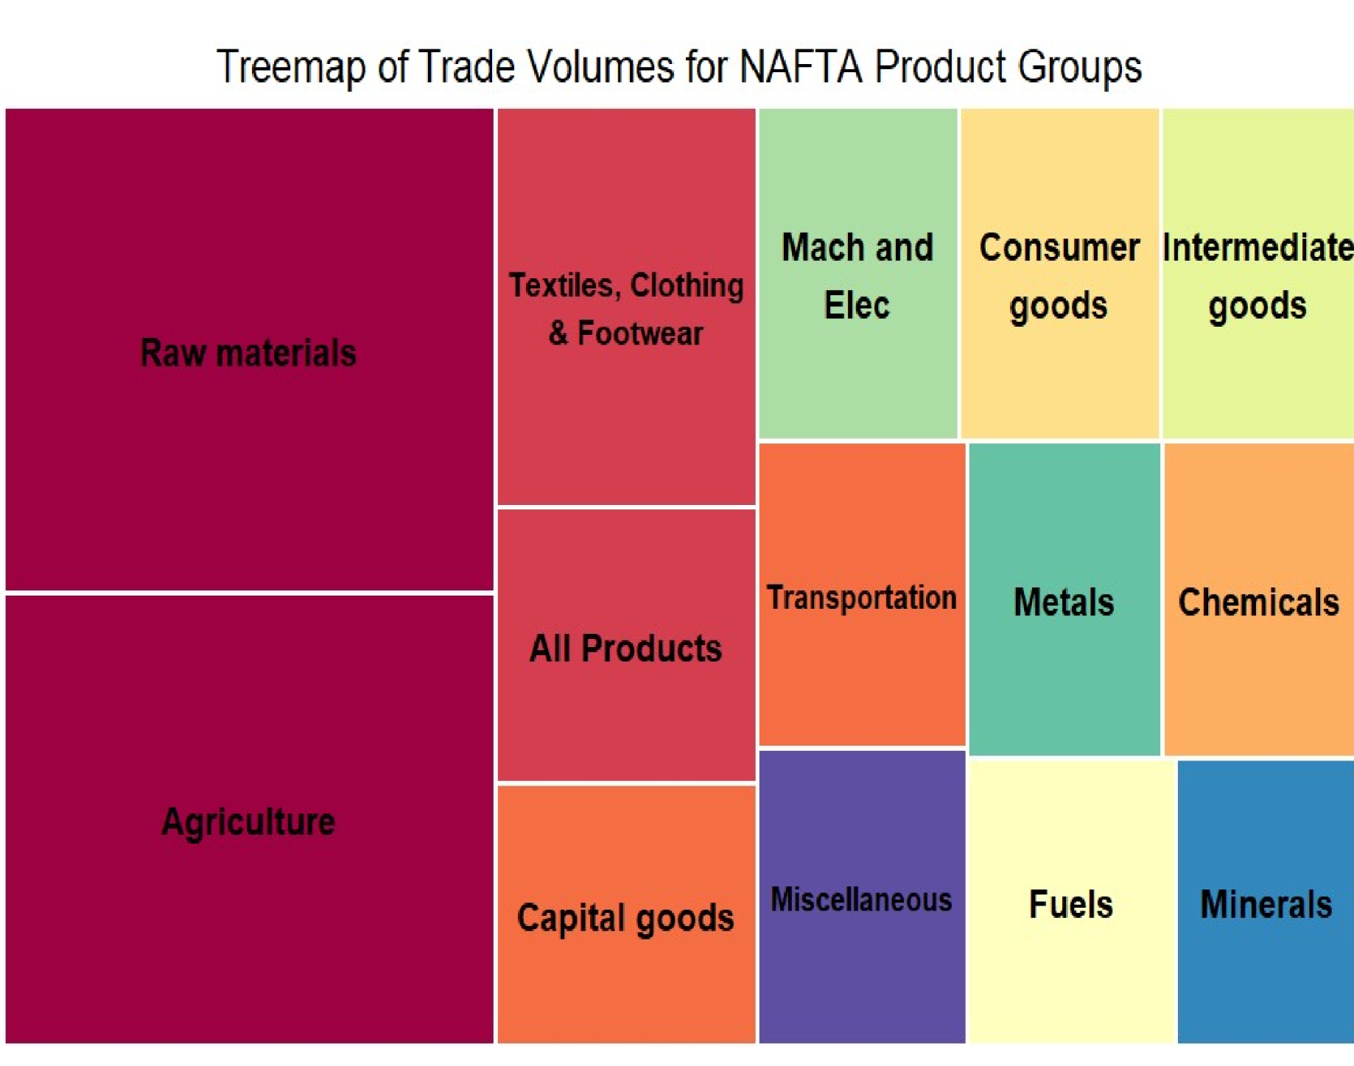

Slide 6
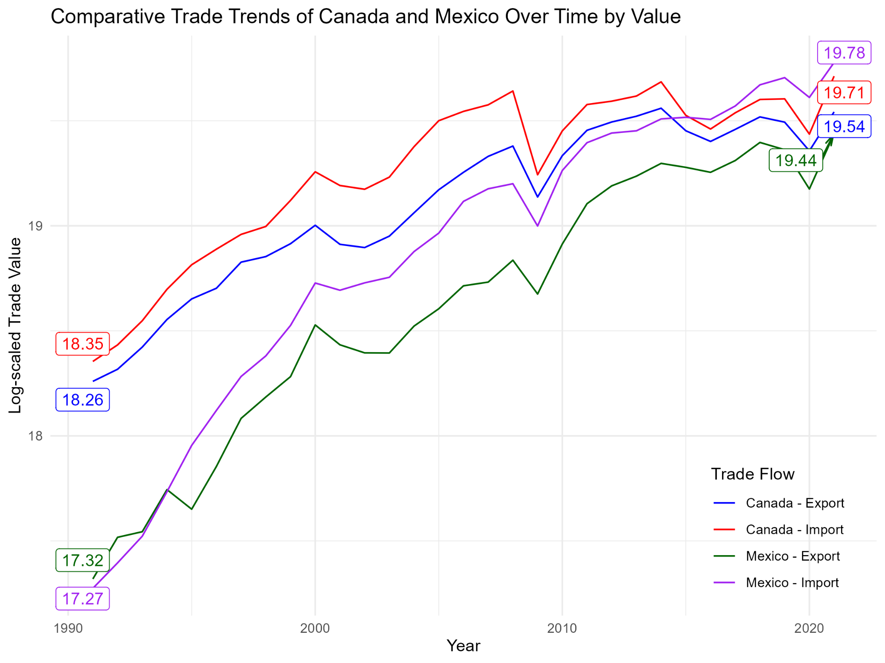

Slide 7
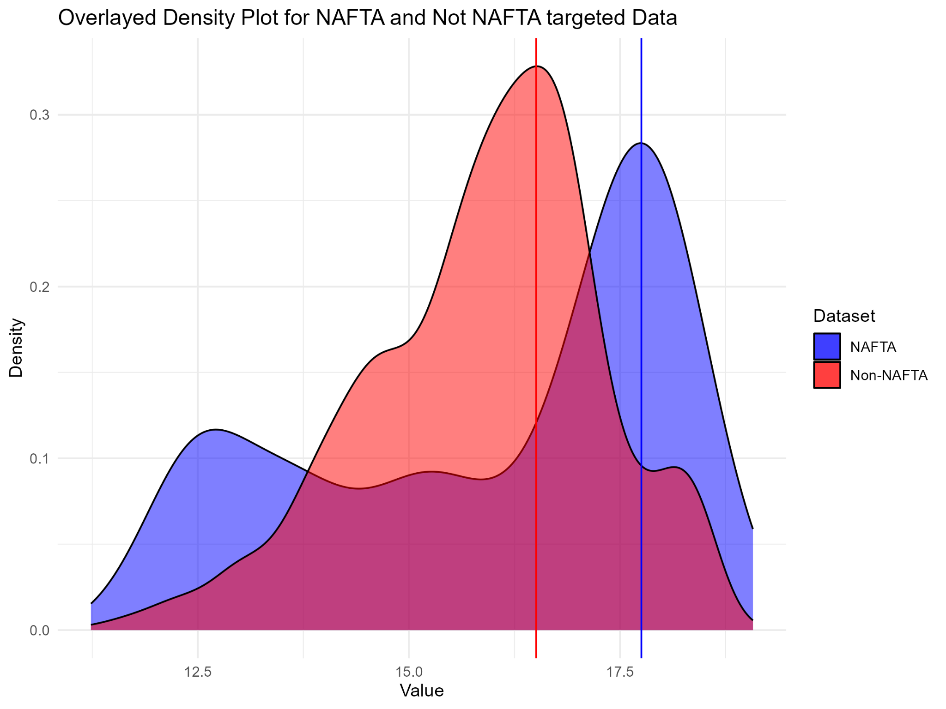

Slide 8
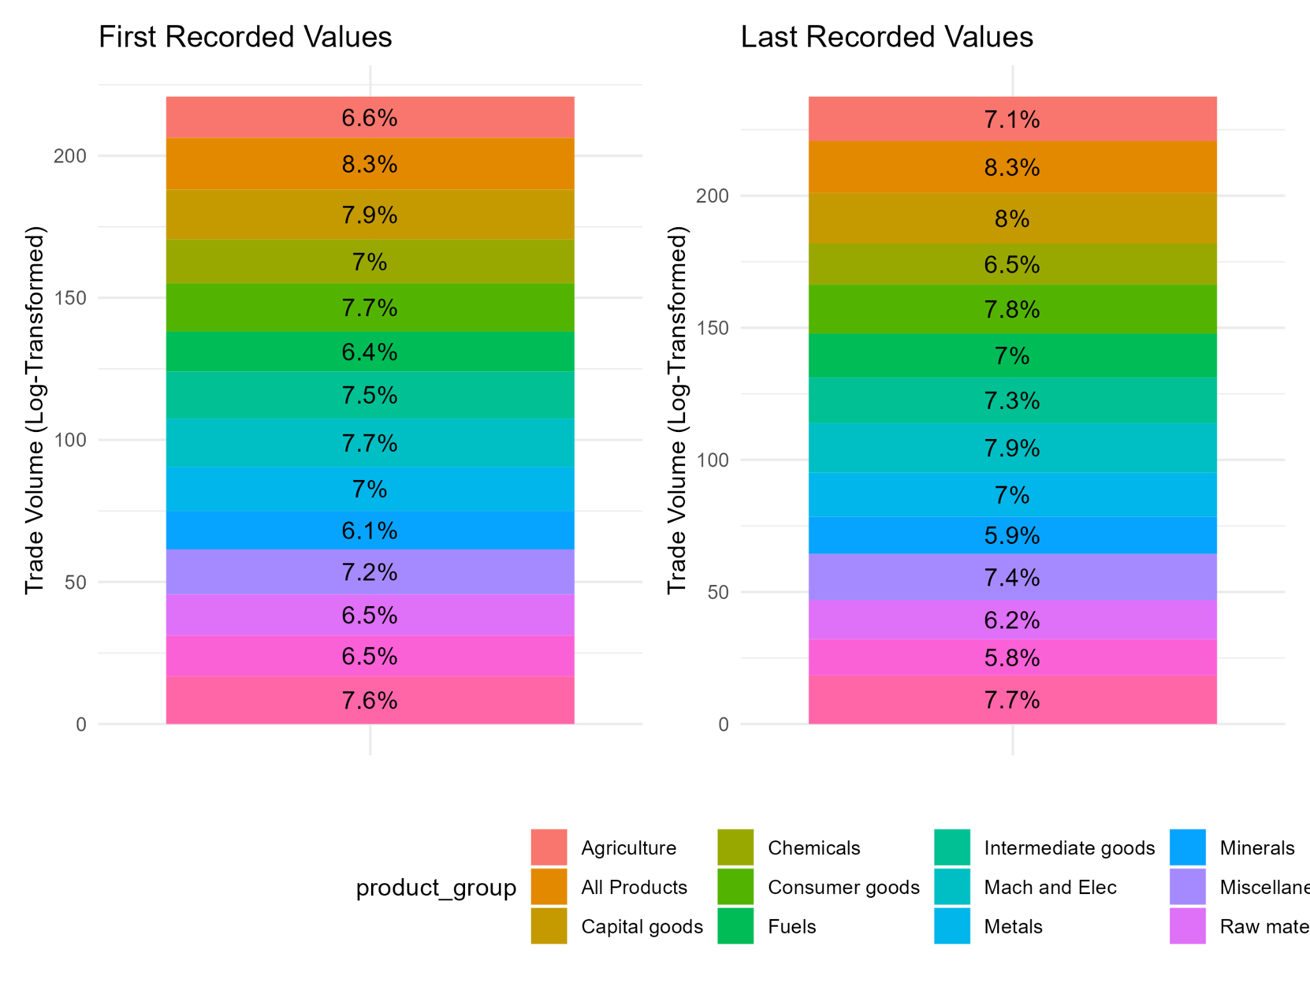

Slide 9
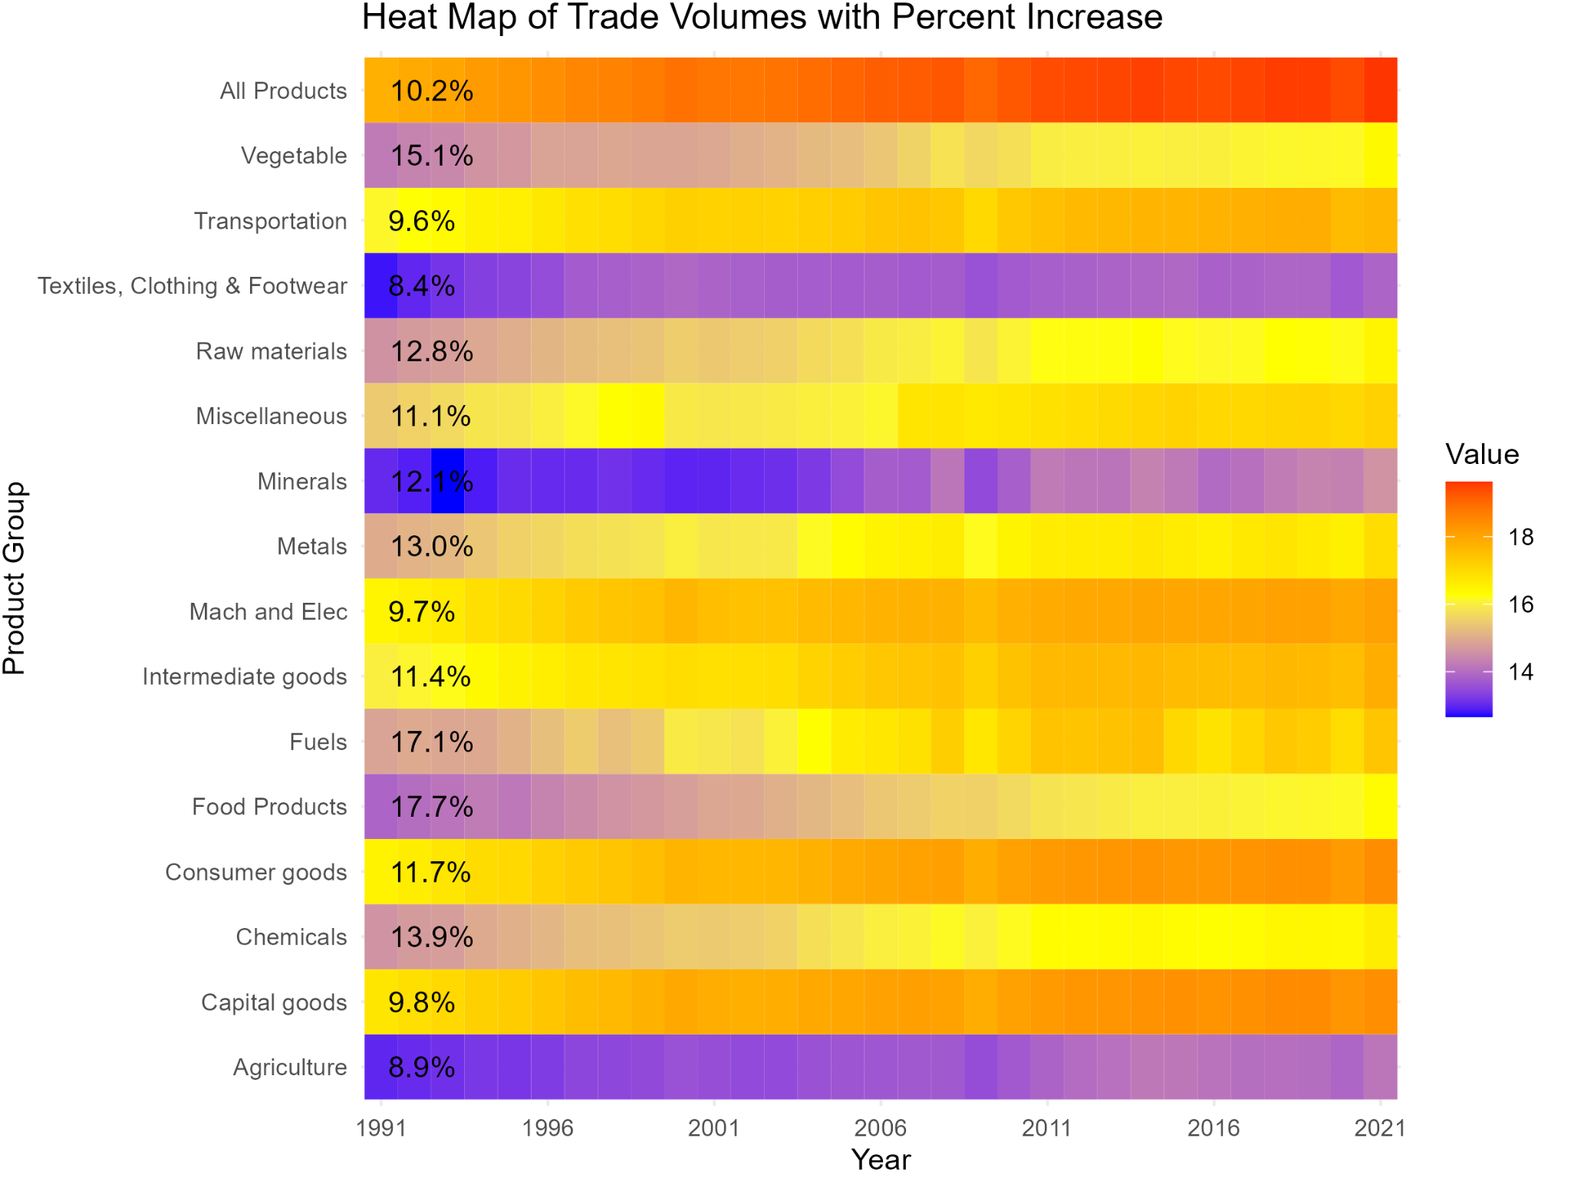

Slide 10
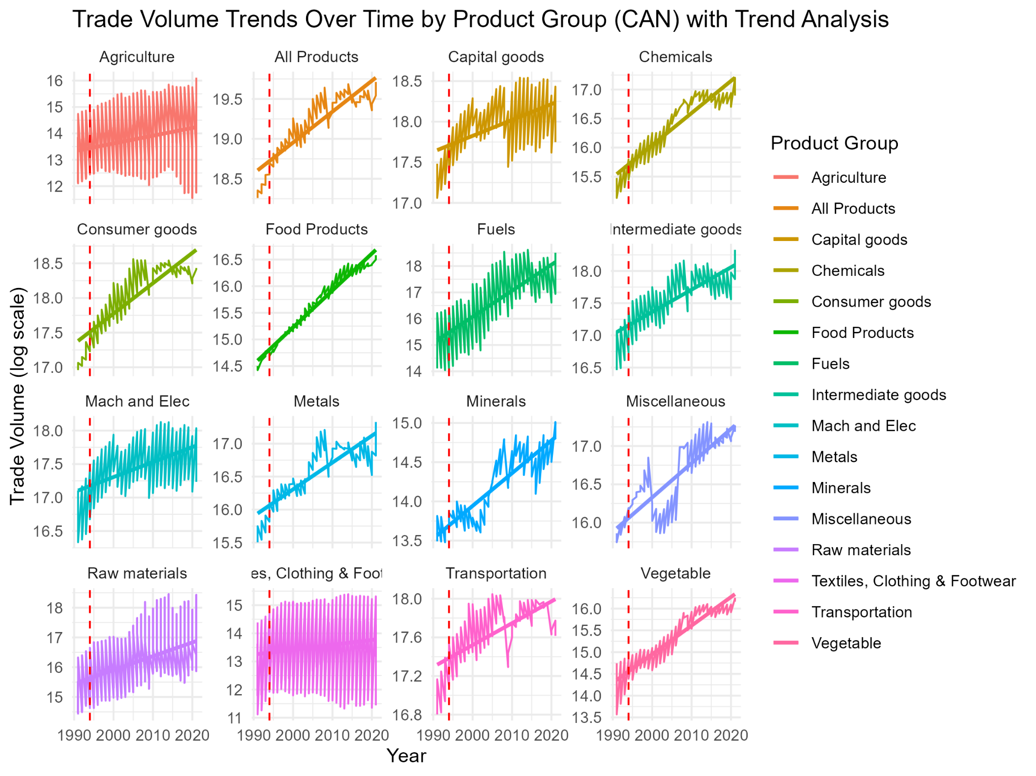

Slide 11
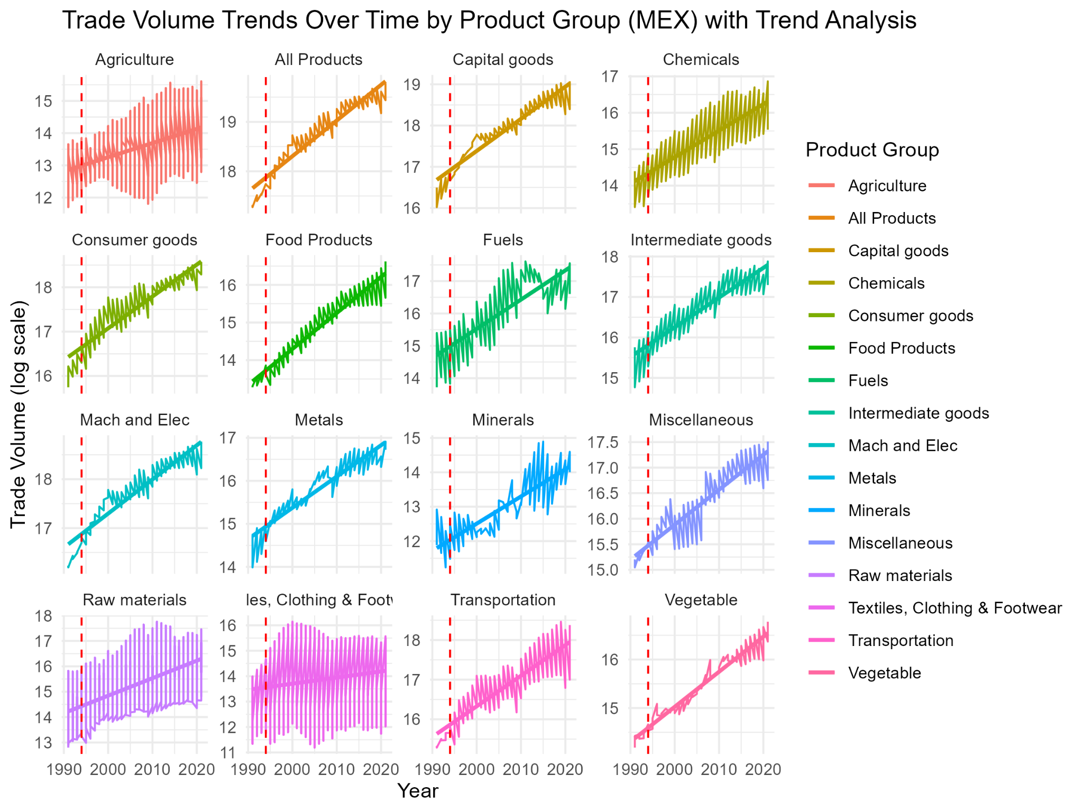

Slide 12
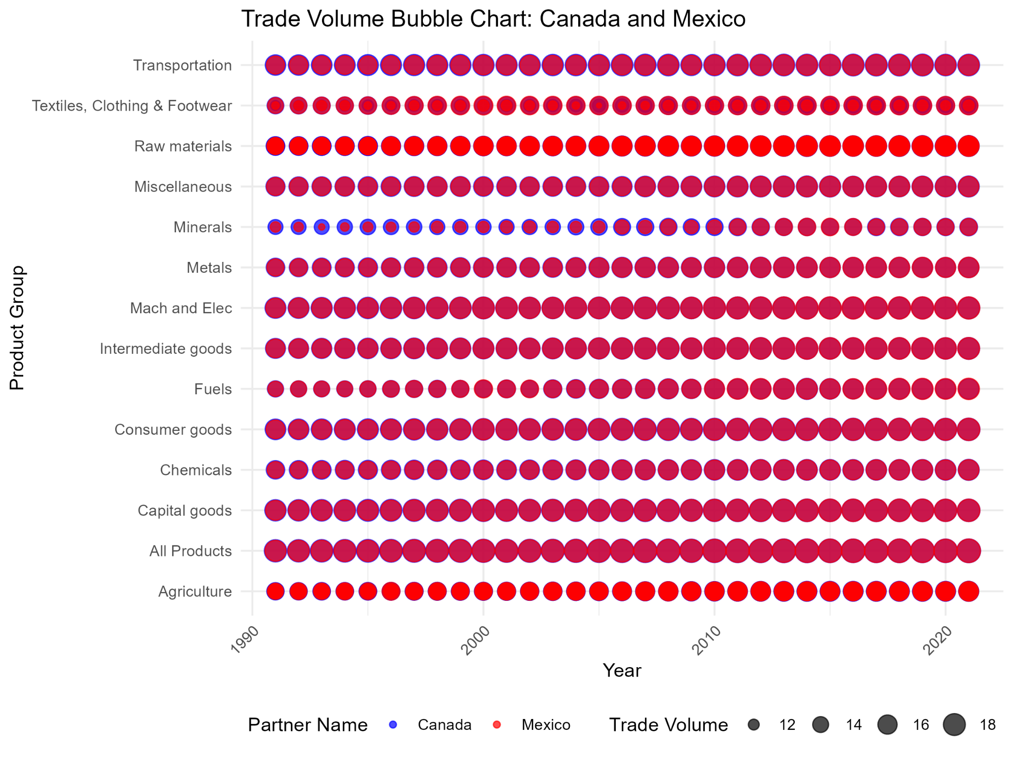

Slide 13
Conclusions:
Mexico benefited significantly more than Canada
The Agriculture Product Group saw the largest increase for (MEX)
NAFTA’s goal of increasing trade volume was achieved.
All sectors experienced an increase
Other possible reasons to consider regarding the increase:
Lager Global Trends
Exodus of China
Types of labor force
Larger overall consumption trends
Inflationary and/or monetary pressure

Slide 14


